Slide 1
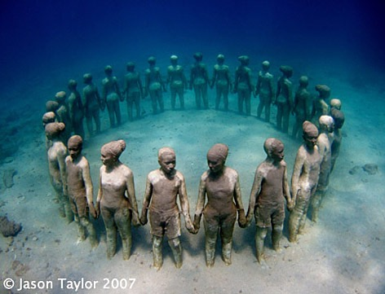
Corruption in Spain. Citizen engagement.
MAR INTROINI

Slide 2

CORRUPTION IN SPAIN
More than 1700 open corruption cases.
More than 1900 people charged
Corruption and financial crisis: they feed each other
Index of corruption perception 58/100

Slide 3
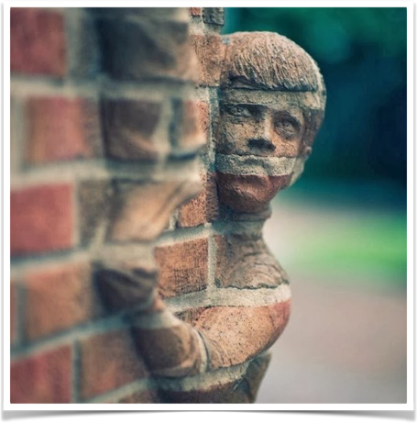
the wall
cultural aspects: feeling from the citizenship that the public system is not part of them
citizens not as a owner of the process but just clients
no proper mechanisms for feedback or if there are ineffective and with no much impact.
limited information to reassure the idea of “superpower” public institutions

Slide 4

WHO
Led by a platform constituted by a coalition of organisations from civil society.
Citizens are main actors but the personal link with public institutions is done by representatives of the organization participant in the platform.
Reshape of official institutions by citizen engagement of civil servants. Towards a e-governance
Active participation from the political parties as main agents of transparent mechanisms and personal integrity of their candidates.

Slide 5

HOW
GENERAL WEBSITE leading the platform and linked with the rest of the organization
ONLINE PLATFORMS in each organization participant from the civil society
SOCIAL MEDIA and intensive use that serve to publicize failures of the system.

Slide 6
WHAT
Reinforce the sense of civil duty and collectiveness towards a common goal of eradicating corruption
Civil servants engagement as another key factor to access to secretive information
Role of political parties as responsible for the moral integrity of their candidates.

Slide 7
HOW DOES IT WORK
Use of IT platforms for each organisation participant in the project and linked with a main ANTICORRUPTION website
Massive use of SOCIAL MEDIA as a factor to boost investigation and report irregularities.
Periodically PERSONAL MEETINGS with representatives of public institutions with organizations participants. (citizens active engagement is going through them)
POLTIICAL PARTIES as an essential role in prevention. Their involvement represents a guarantee of success,assuring candidates with ethics.

Slide 8
RISKS
The lack of practice in being a “controller” of the State and not just a voter.
The lack of participation due to a negative feeling that could not influence the State.
The strong barrier of the own public structure towards citizen´s involvement
Supremacy of Spanish public institutions.
Reserved information.

Slide 9
OPPORTUNITIES
The important sensitization of Spanish citizens around multiple corruption cases in this historical moment.
Financial crisis: that left the idea that public representatives are not taking the correct decisions
High and sustained rate of unemployment (over 20% for more than 7 years) associated to a mistaken public strategy, also to a corrupt management that does not invest in productivity.

Slide 10
INDICATORS
SURVEY
CONSULTATION
POLLS.
STATISTICAL ANALYSIS

Slide 11
CONCLUSION
Mechanisms of citizen engagement in an ongoing process are the only hope for getting enough transparency and accountability
Education for political parties on their candidates in terms of values and ethics is paramount to overcome corruption
Complicity and engagement from civil servants to provide secretive information.

Slide 12
Thank you for your time and dedication.
Best,
Mar Introini

